Slide 1
Dissertation Proposal: User Interfaces for the Coq Proof Assistant
Benjamin Berman
Notes:
Good morning. Thanks for coming to my dissertation proposal presentation, which has to do with user interfaces for the Coq Proof Assistant

Slide 2
Outline
My general goals
Theorem Proving with Coq
Briefly go through an example
Survey—evidence of room for improvement
Research Plans
General strategy
Specific problems I’m addressing
User testing
Possibly unique for this sort of work
Rough timeline for research
Notes:
Here’s an outline of this talk.
I’m going to start by discussing my general goals and some of their motivation
I’m going to briefly go through an example of theorem proving with Coq to give you at least a little bit of a sense of some of the challenges I am trying to help out with
I’ll talk a little about a survey that was sent to Coq users and which gives additional evidence that there is room for improvement
I’ll then talk about my research plans, including my general strategy, specific problems I’m addressing, and some planned user testing.
I should say that this user testing, and the user-centered approach being used here, is pretty unusual for projects of this sort, probably unique, and I’ve been lucky enough to have the combination of Professors Stump and Hourcade involved in this project.

Slide 3
Research Goals
Goal 1: Improve usability of the Coq Proof Assistant and other interactive theorem provers (ITPs) more generally
Motivation:
ITPs are tools for developing and checking proofs
Used to formalize and check general mathematics
Can be used in education
Used for development of more reliable computing systems
Reliability is becoming more and more important as computers are used more and more in aviation, banking, health care, etc.
Coq is one of the best developed and most widely used ITPs
Complex and not easy to learn/use
Ideas (and code) developed specifically for Coq can be reapplied to other ITPs
Notes:
The first goal is to improve usability of the Coq Proof Assistant, and other interactive theorem provers more generally
To understand why we want to do this you should first know that interactive theorem provers are tools for developing and checking proofs
They can be used to formalize and check general mathematics.
They have some potential uses in education.
They also are being used in the development of more reliable computing systems.
Reliability is becoming more and more important as computers are being used more and more in aviation, banking, health care, etc…areas where you really don’t want bugs.
Coq is one of the best developed and most widely used interactive theorem provers.
A notable achievement has been the development of a certified C compiler and
just this summer it won an award from the ACM Programming Languages Special Interest Group.
A big problem with the tool, though, is that is very complex and not easy to learn or use…that’s where this work comes in,
And many of the ideas, and much of the code, may be reapplied to other theorem provers.
Actually, I think many of the ideas developed in this project can be reapplied to environments beyond just theorem provers…

Slide 4
Research Goals
Goal 2: Improve usability of coding environments
Coq has many complexities and therefore many opportunities for designing helpful interfaces
E.g. the proof development mechanism can be used to write programs
Coq’s language pushes at the edges of what is considered practical
By making Coq easier to use, we are expanding the range of practical programming languages
Notes:
…which brings us to the second general goal, helping to improve the usability of coding environments more generally.
Coq is actually a good setting for such research, for a couple of reasons.
First, its many complexities provide a lot of opportunities for designing helpful interfaces.
One complexity, for instance, is that the proof development mechanism can actually be used to write programs.
Second, the complexity of Coq’s language pushes it to the edges of what is considered practical for real-world programming projects,
so by making Coq easier to use, we are expanding the range of practical programming languages
as well as making current mainstream languages easier to work with.

Slide 5
Theorem Proving with Coq
Two main user interfaces
CoqIde
Proof General
A very simple example:
Prove that
(A -> B -> C) -> (A -> B) -> A -> C
where A, B, and C are “Prop”s.
Note that this is equivalent to
(A -> (B -> C)) -> ((A -> B) -> (A -> C))
Notes:
There are two main user interfaces for Coq—CoqIde and Proof General.
They are quite similar, so I’ll stick with CoqIde for this example.
We are going to prove that
(A -> B -> C) -> (A -> B) -> A -> C
where A B and C are propositional variables.
Note that the arrow operator is right associative, so fully parenthesized this would look like this.

Slide 6
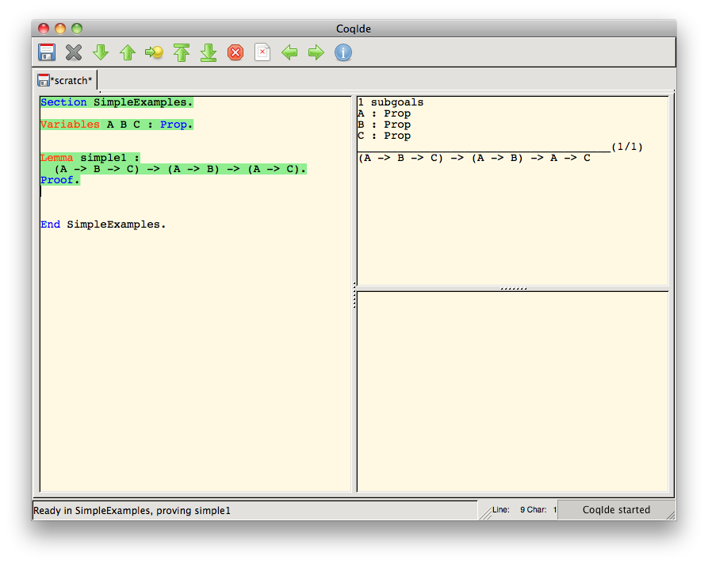
Theorem Proving with Coq: Get Things Set Up
Notes:
We first have to get things set up,
so we type in our variable declarations
and the lemma we want to prove
and then we move this highlighting forward in the text area.
Over here, on the right, we see the result of evaluating the final highlighted sentence on the left.
In this case we’ve got our initial goal, which includes a context, written above the line here.

Slide 7

Theorem Proving with Coq: Enter & Evaluate Tactics
Notes:
We can change our goal by entering a “tactic”, “intro H”, over here…

Slide 8
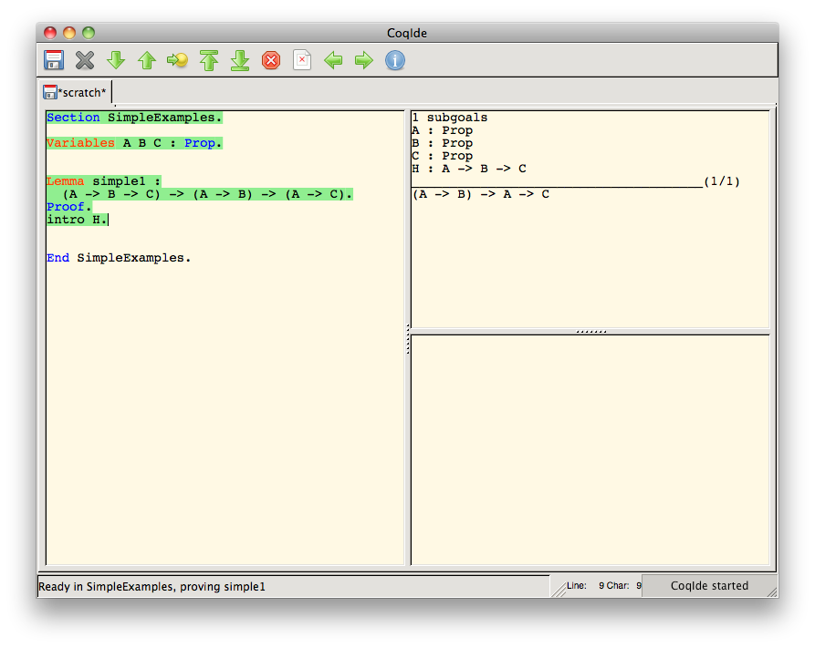
Theorem Proving with Coq: Enter & Evaluate Tactics
Notes:
…and evaluating it. And we see that we have replaced our old goal with a new one.

Slide 9
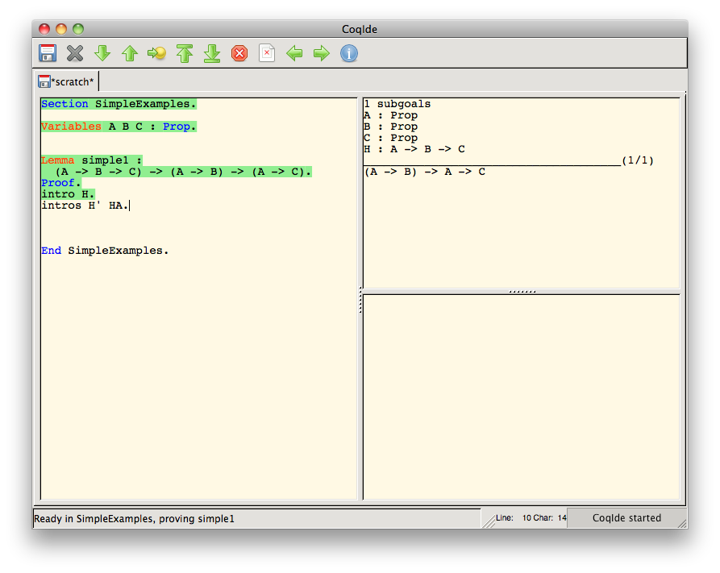
Theorem Proving with Coq: Enter & Evaluate Tactics
Notes:
We continue entering tactics to change what we see on the right side here.

Slide 10
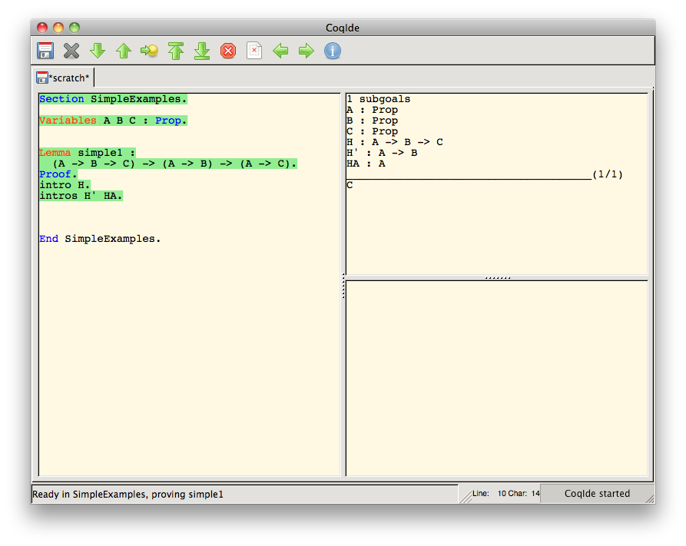
Theorem Proving with Coq: Enter & Evaluate Tactics
Notes:
…here’s the result of intros H’ HA

Slide 11

Theorem Proving with Coq: Enter & Evaluate Tactics
Notes:
…

Slide 12
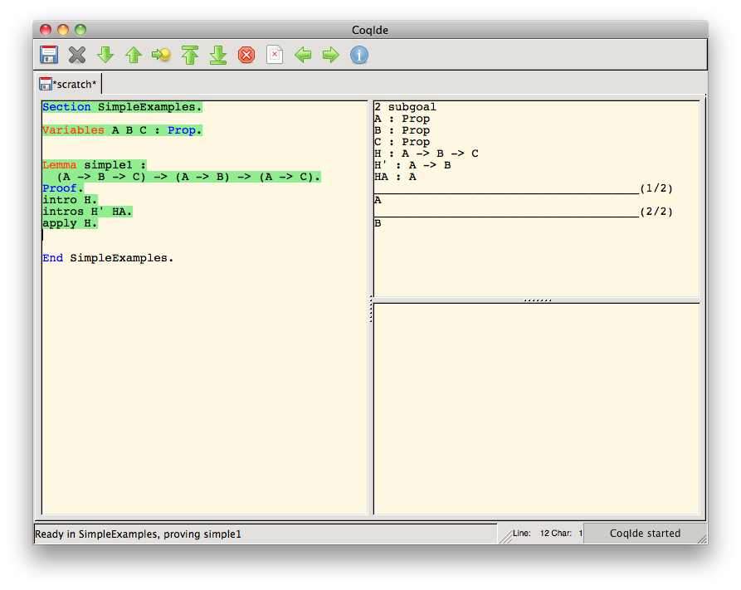
Theorem Proving with Coq: Enter & Evaluate Tactics
Notes:
Apply H actually replaces the earlier goal with two new goals.
We’ll be dealing with just this first one for now.

Slide 13

Theorem Proving with Coq: Enter & Evaluate Tactics
Notes:
We are able to get rid of this first goal by entering “exact HA”…

Slide 14
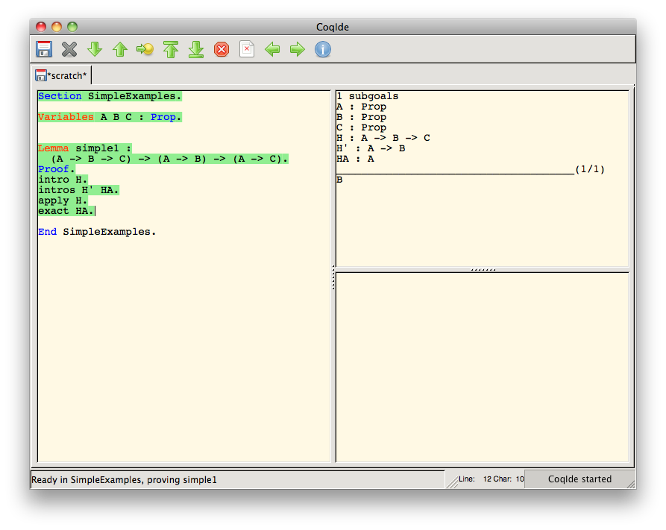
Theorem Proving with Coq: Enter & Evaluate Tactics
Notes:
…and we can get rid of the second goal by entering…

Slide 15

Theorem Proving with Coq: Enter & Evaluate Tactics
Notes:
…apply H’…

Slide 16
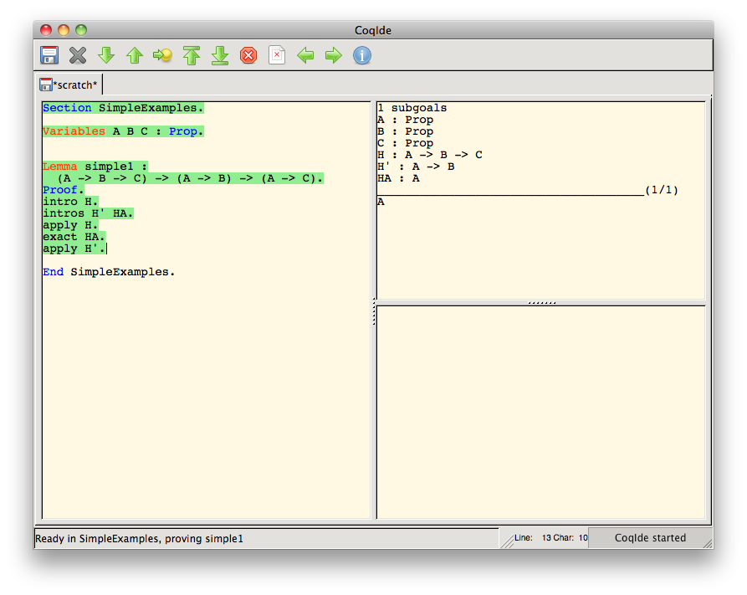
Theorem Proving with Coq: Enter & Evaluate Tactics
Notes:
…

Slide 17
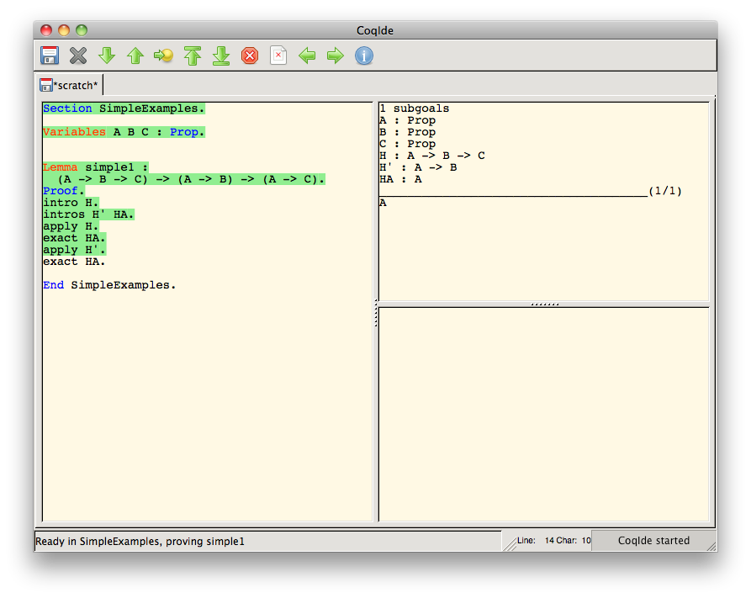
Theorem Proving with Coq: Enter & Evaluate Tactics
Notes:
…and then “exact HA” again.

Slide 18
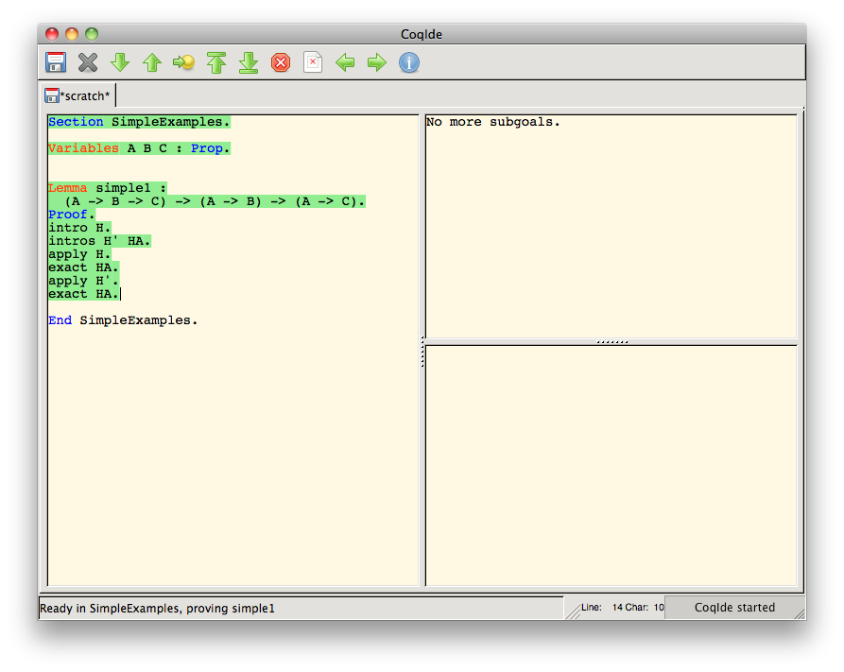
Theorem Proving with Coq: Enter & Evaluate Tactics
Notes:
Now that we’ve gotten rid of all the goals on the right, we’ve proved our lemma…

Slide 19

Theorem Proving with Coq: Final Check and Saving of Proof
Notes:
…and we can enter “Qed”…

Slide 20
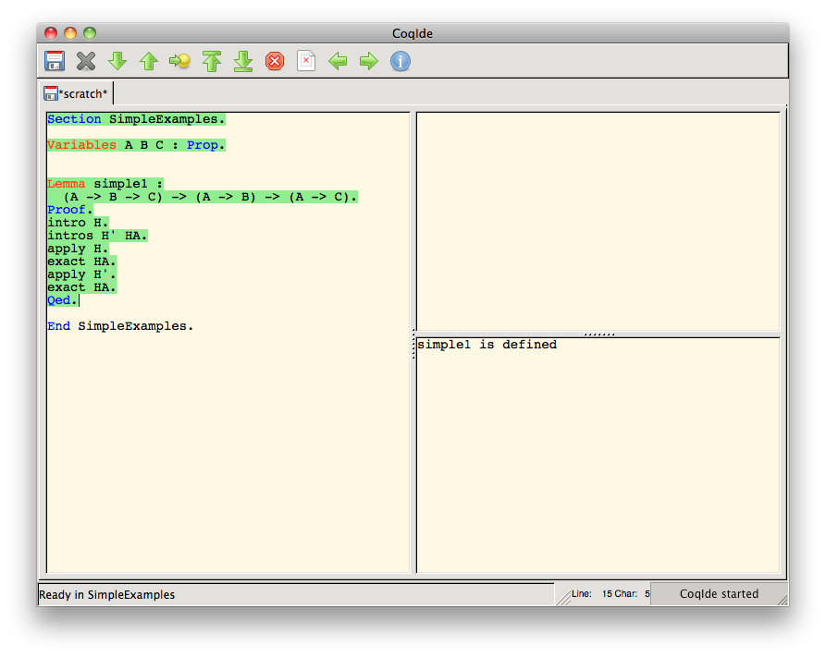
Theorem Proving with Coq: Final Check and Saving of Proof
Notes:
…to do a final check of the proof and save it.

Slide 21
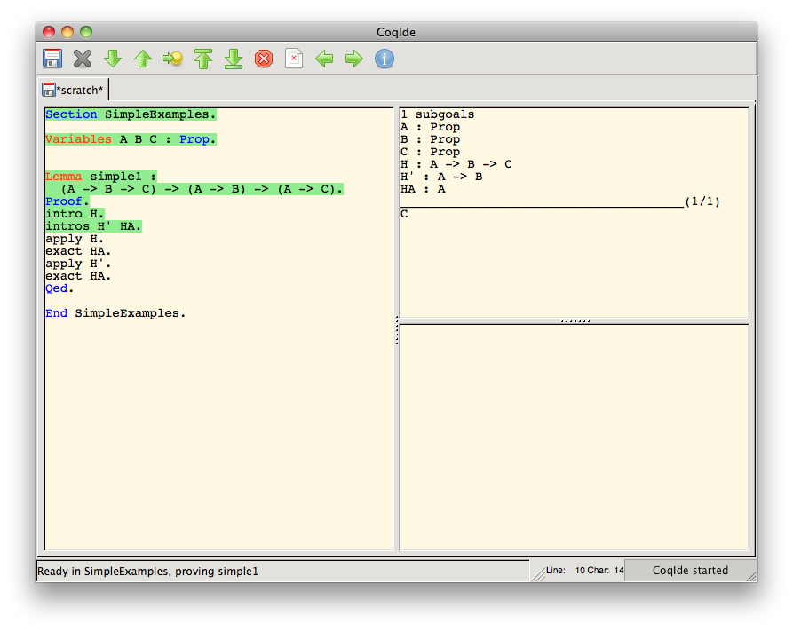
Theorem Proving with Coq: Moving Back
Notes:
We can also move the highlighting backwards to un-evaluate part of the proof script…

Slide 22
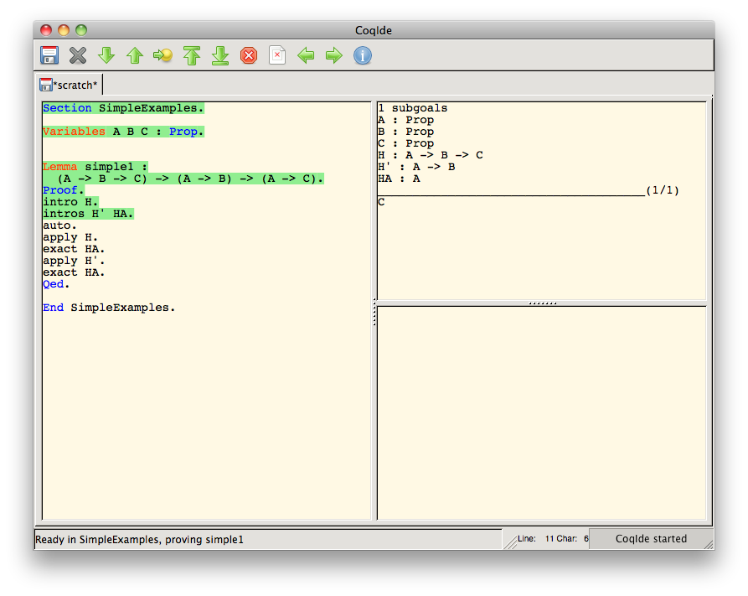
Theorem Proving with Coq: Automatically Proving the Lemma
Notes:
…and try to prove this earlier goal using some other tactic, maybe “auto”…

Slide 23
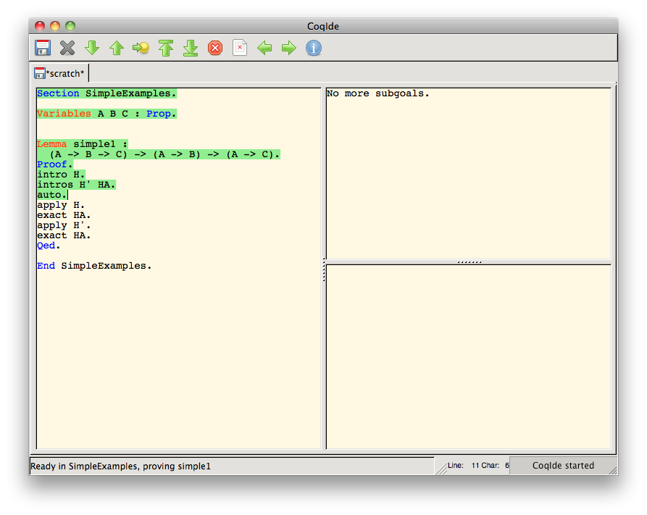
Theorem Proving with Coq: Automatically Proving the Lemma
Notes:
…which is able to automatically prove the lemma.
This example really just scratches the surface of what is possible in Coq.

Slide 24
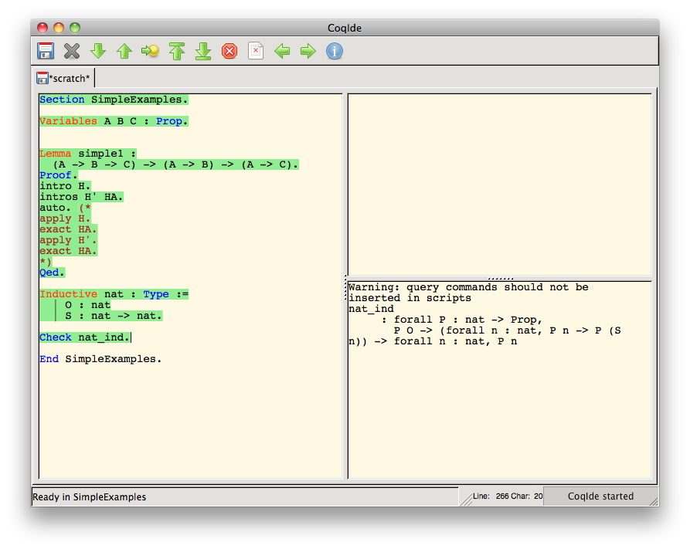
Theorem Proving with Coq: Natural Numbers
Notes:
Scratching the surface just a little bit deeper, we see here how we can do things like define inductive types, like natural numbers,
and automatically generate induction principles like we see over here.

Slide 25
What the example shows (or, at least, what it starts to)
One of the big tasks for Coq users is to figure out what these tactics do
This task is challenging for several reasons
There are lots of tactics whose effects are dependent upon the given arguments and goals
Seeing the effects of tactics requires awkward movement through the proof script
There is a lot text that has to be sorted through
Notes:
What we’ve started to see here in this example is that one of the big tasks for Coq users is to figure out what tactics do.
This is a challenging task for several reasons
First, there are lots of tactics. There are almost 200 standard ones listed in the back of the reference manual, and users can actually write their own. And the effects of these tactics of course depend on the arguments and goals they are given.
Second, and unfortunately the example I gave doesn’t do a great job of show this, seeing the effects of tactics can require some very awkward movement through the script
Finally, there is just a lot of text that has to be sorted through.

Slide 26
Survey
There are lots of other problems to face, including ones for expert users
To verify this, a survey was sent to Coq-Club mailing list subscribers
48 responses
Almost 4,500 words in response (total) to the essay questions
Results presented at the 2012 Coq Workshop
Notes:
So there are a lot of other problems to face, including ones for expert users,
And to verify this, we sent a survey to subscribers to the Coq-Club mailing list.
We got 48 responses, and almost 4,500 words in response to the essay portions of the survey,
which I think reflects some strong interest in these issues,
and I presented the results at the 2012 Coq Workshop.

Slide 27
Survey
My general impression from the responses:
Appreciation of existing interfaces
Some specific tasks we identified as difficult were indeed perceived as difficult, including
understanding the relationships between subgoals
switching back and forth between potential subgoal proofs
comparing similar subgoals
telling what options are available for proving a subgoal
Many helpful features could be added, in particular:
features seen in programming IDEs, like refactoring
representations of proof structure
Notes:
I’m not going to go into any of the details of the survey, but my general impression from the responses was that
while there is appreciation for existing interfaces
some tasks that we identified as difficult were indeed perceived as difficult and
many helpful features could be added, especially features seen in programming environments and ways of representing proof structures.

Slide 28
Research Strategy
Develop basic UI, similar to CoqIde/PG
Create extensions
Address specific problems
Get feedback, along the way, from users
Compare performance with and without the extensions
Notes:
The strategy I’m following in this research is to first develop a basic user interface, similar to CoqIDE and Proof General,
Create experimental extensions that address specific problems,
getting feedback along the way,
And compare performance with and without the extensions

Slide 29
Basic User Interface
Calling it “CoqEdit”
jEdit plugin
jEdit is an open source, full-featured editor written in Java
jEdit plugins have dependency mechanism—we can write plugins for plugins
Notes:
The basic user interface we are calling “CoqEdit”, at least for now.
CoqEdit is a jEdit plugin, and jEdit, is an open source, full-featured editor written in Java.
One thing to know about jEdit plugins is that they have a dependency mechanism which basically allows us to write plugins for plugins—in this case, plugins that plug into CoqEdit as well as jEdit.

Slide 30
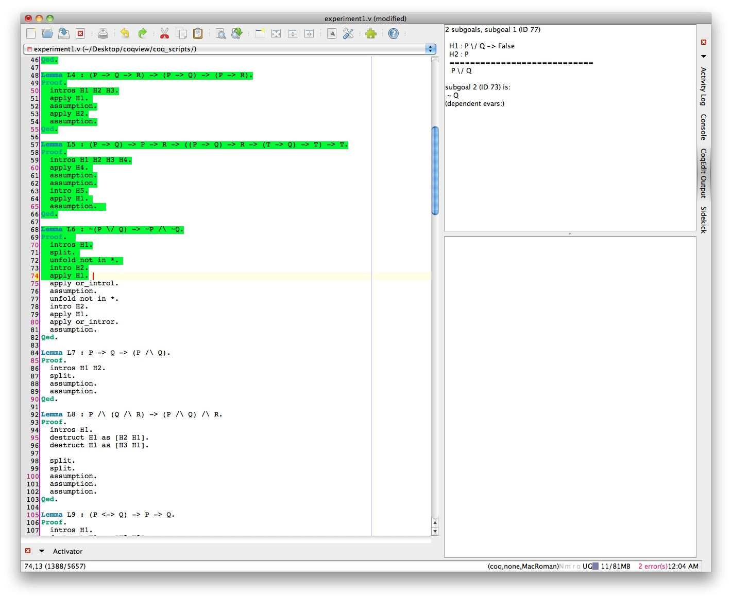
CoqEdit (our initial version)
Notes:
Here’s a screenshot of an initial version Harley Eades, another grad student, and I put together.

Slide 31
Problems
Hard to view results from earlier sentences
tactics may run for a long time
Hard to “be” at multiple positions
Notes:
There are a couple problems with this, related to one another, that I’m currently dealing with in a revision the Basic CoqEdit plugin rather than an extension.
First, it is sometimes difficult to view the results from earlier sentences because normally one has to un-evaluate and then re-evaluate tactics, and this re-evaluation can take quite a while.
The obvious basic solution to this problem, which I’m adding to the revision, is to cache the results of evaluation.
Once we have this cache, we want a technique for showing what is cached and what cached result we are looking at.
We also want a technique that can be easily extended so as to show results from multiple positions in the cache at once.

Slide 32
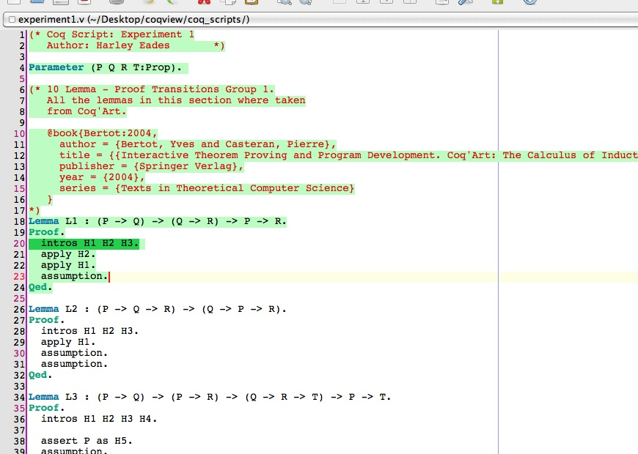
Solution: CoqEdit, revised version
Notes:
The way I’m doing this in the revision is to add extra highlighting, as seen here, to show what results we are looking at within the evaluated region.
This should give the basic version of the CoqEdit user interface at least one advantage over the two main current interfaces.

Slide 33
Extensions
Three extensions planned
Experiment planned for #1 and #2
Extension #3 preliminary work
Designing it for classroom testing
Notes:
We currently have three extensions to CoqEdit planned.
For extensions 1 and 2, we have an experiment with human participants planned already.
There is no currently planned experiment for the third extension, but I am designing it so it could be easily used in a classroom and tested that way.

Slide 34
Extension #1: “Proof Previews”
Problem: knowing what to do next
Solution: generate possible tactics
Problem: quickly seeing results of these tactics
Solution: allow users to toggle through tactics and show result of selected tactic
Notes:
The first extension we are calling “Proof Previews.” It is probably the most straightforward of the extensions
and the problem that it addresses is knowing what to do next in a proof.
Its solution is to generate lists of possible tactics.
This leads to a new problem—how to quickly see the results of these tactics.
The solution here is to allow users to toggle through these tactics and show the result of the selected tactic.

Slide 35
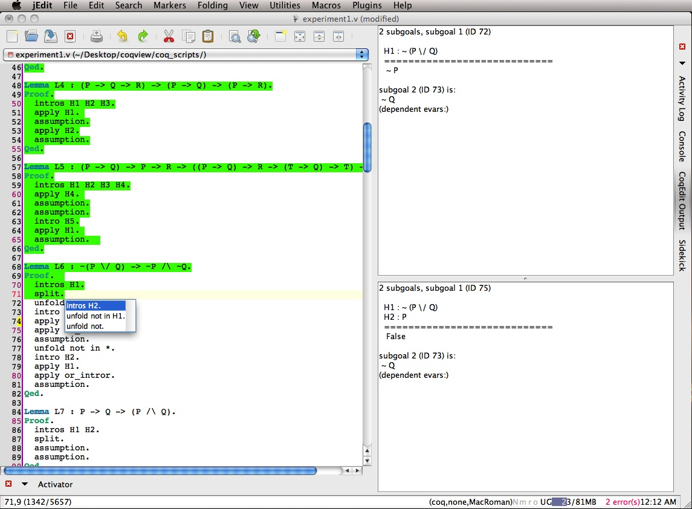
Extension #1: “Proof Previews”
Notes:
Here’s a screenshot of this, incorporated into our initial version of the basic CoqEdit plugin.
On the left, we see this Completion Popup with the list of tactics.
At the bottom right, we see the result of inserting and evaluating the selected tactic.

Slide 36
Extension #2: “Proof Transitions”
Problem: given a tactic,
what goals does it produce
why does it produce these goals
Problem: given a goal
what tactics produced it
why was it produced by these tactics
Solution Part 1: proof tree visualization
Solution Part 2: text change highlighting and animation
Notes:
Extension #2 we are calling “Proof Transitions”
It addresses two related problems.
Given a tactic, what goals does it produce and why
And
Given a goal, what tactics produced it and why.
The solution given in the extension has two parts: proof tree visualization, and text change highlighting and animation.
I’ll start by discussing proof tree visualization.

Slide 37
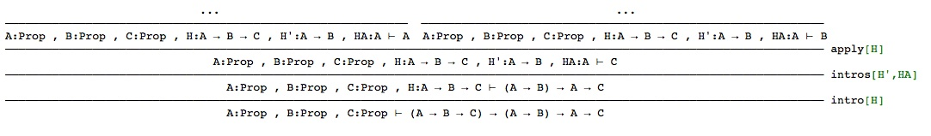
Proof tree visualization
Traditional way of drawing “proof trees”:
Visualization created with ProofWeb. http://prover.cs.ru.nl/.
Notes:
The traditional way of drawing proof trees generally looks something like this,
where we have goals represented as these sequents,
and lines, labeled with tactics, separate parent goal, on the bottom, from child goal (or goals), on the top.

Slide 38
Proof tree visualization
The previous visualization gets “messy”. Instead,
“Overview first”
“Details on demand”
Ben Shneiderman, The Eyes Have It: A Task by Data Type Taxonomy for Information Visualizations. In Proceedings of the IEEE Symposium on Visual Languages, pages 336-343, Washington. IEEE Computer Society Press, 1996
Notes:
This obviously gets quite messy.
What we instead want to do is follow the “visual information-seeking mantra” from Ben Shneiderman and
give an overview first and then
details on demand.

Slide 39
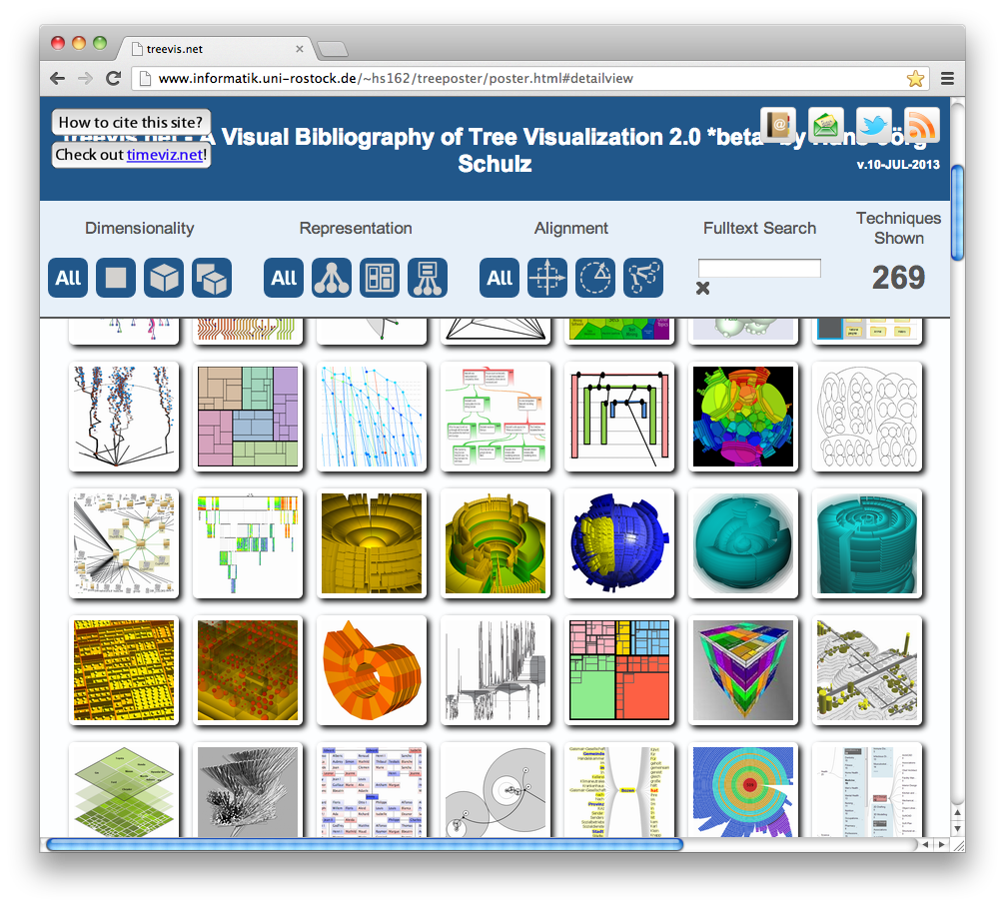
Proof tree visualization
Lots of ways of visualizing trees:
Schulz, H., "Treevis.net: A Tree Visualization Reference," Computer Graphics and Applications, IEEE , vol.31, no.6, pp.11,15, Nov.-Dec. 2011 doi: 10.1109/MCG.2011.103
Notes:
Obviously there are lots of ways of visualizing trees, so there is quite a large space in which to search for a better visualization.

Slide 40
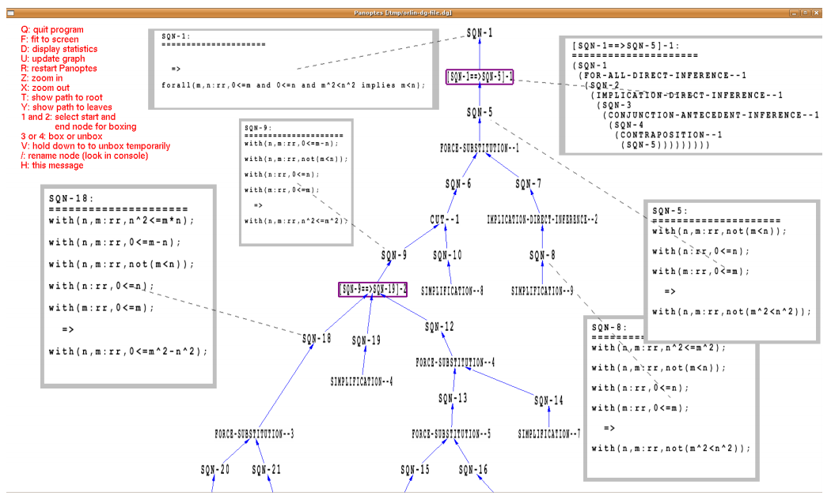
Proof tree visualization
William M Farmer and Orlin G Grigorov. Panoptes: An exploration tool for formal proofs. Electronic Notes in Theoretical Computer Science, 226:39–48, 2009.
Notes:
I should note that this sort of visualization has been done before, albeit with some limitations. For instance, here we see a visualization, created using a tool called Panoptes, of a proof developed using the IMPS theorem prover.
Switching gears to the second part of extension #2…

Slide 41
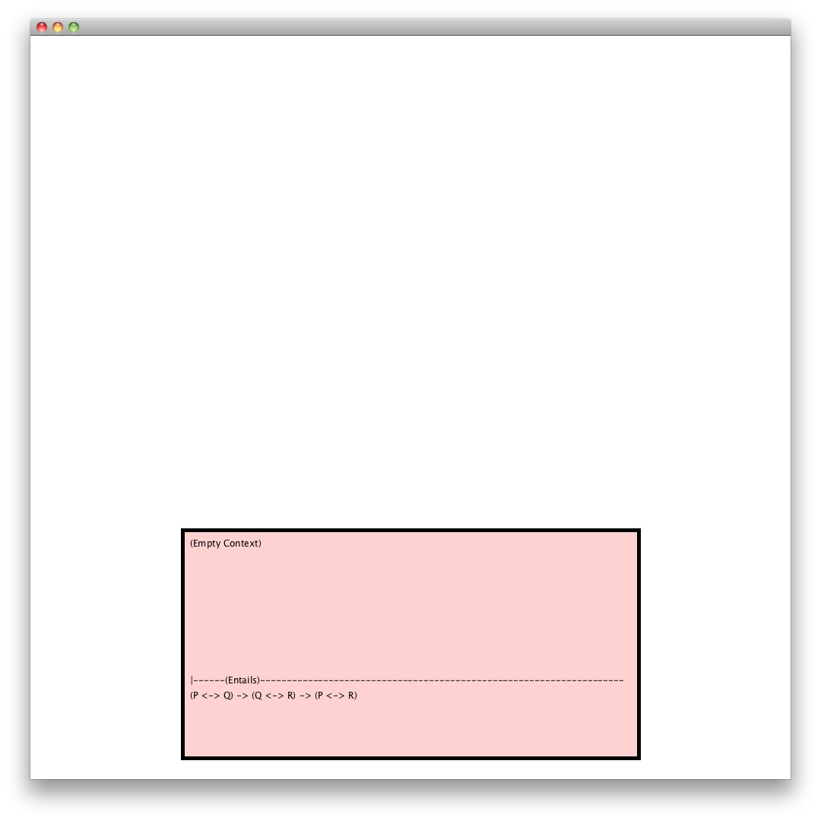
Text change highlighting/animation
Notes:
Here’s my initial stab at implementing some helpful text highlighting and animation; sorry, I still need to play around with font sizes. Starting with our current goal here…

Slide 42
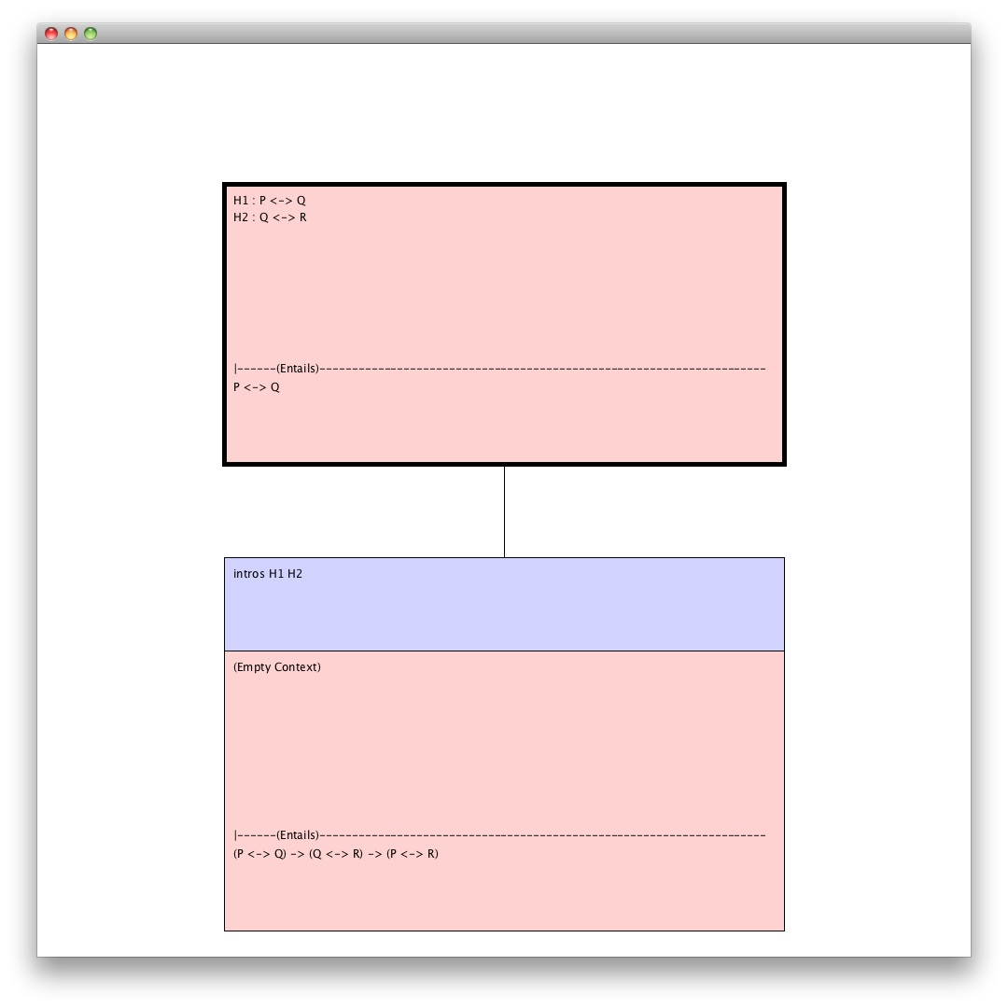
Text change highlighting/animation
Notes:
after we have entered a tactic we may see the new current goal drawn above, as so, with the tactic used to generate it directly above the parent goal.

Slide 43
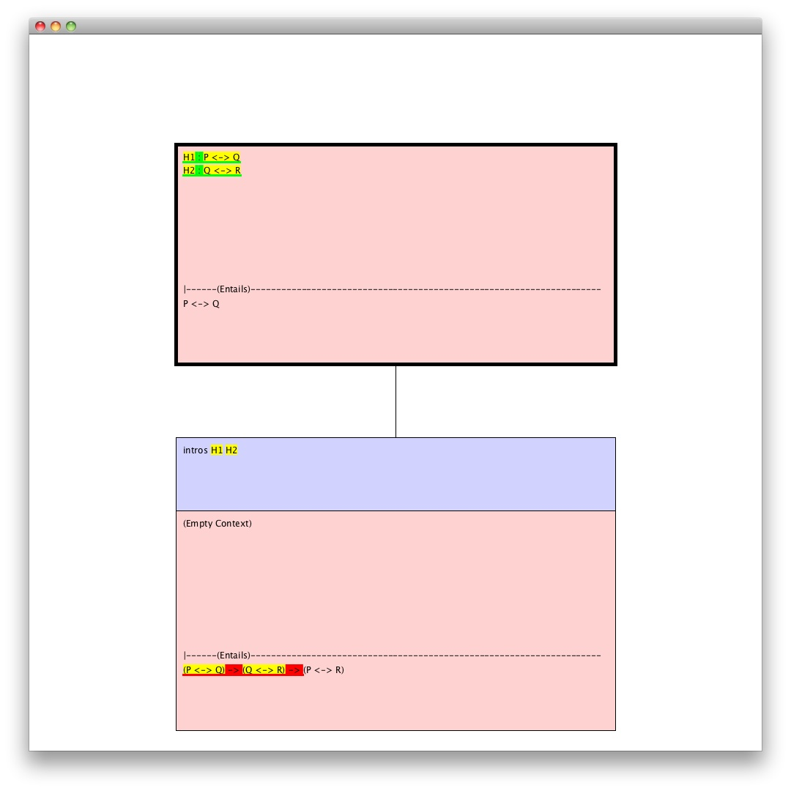
Text change highlighting/animation
Notes:
We can then add some highlighting: green for new text, red for text that disappears, and yellow for text that gets moved or copied.

Slide 44
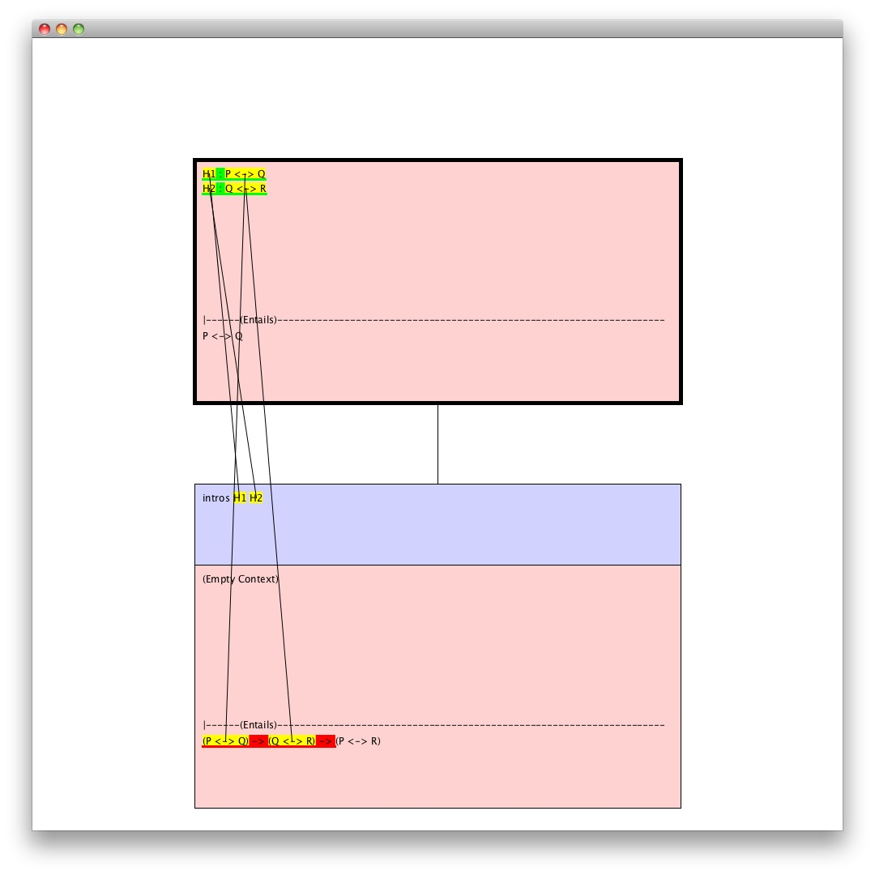
Text change highlighting/animation
Notes:
…and then we can add some animation, like lines that, in the actual software, appear one by one, to show where text has been moved. I may actually have the various bits of text float up, one by one, to show this.

Slide 45
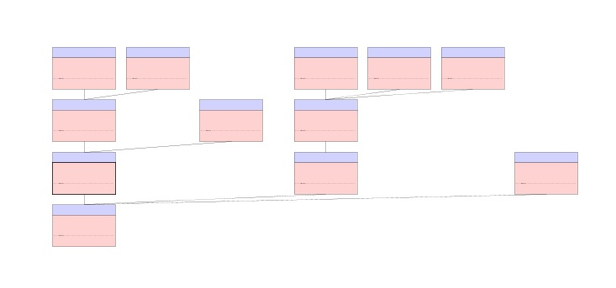
Integrating proof tree visualization
Notes:
What’s nice about the library I’m using to implement this is that we can easily allow the user to zoom out, from here, to see the structure of the tree as well as the contents of the current node and its parent…

Slide 46
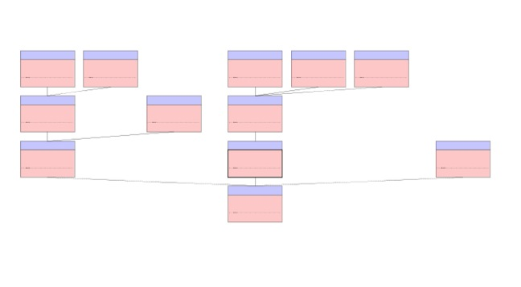
Integrating proof tree visualization
Notes:
…and we can rearrange the nodes automatically to keep the current node, here, above its parent for when we zoom back in.

Slide 47
Extension #3: “Propositional Logic Syntax Shortcuts”
Problem: how to easily understand the structure of complex expressions (parsing)
Problem: how to easily select and manipulate sub-expressions
Solution Part 1: “Syntax Tree Highlighting”
Solution Part 2: “Keyboard-Card Menus”
N.B.: these are very general problems/solutions
Notes:
The third extension, Propositional Logic Syntax Shortcuts, tries to solve another pair of problems with another pair of solutions.
The first problem is how to make sense of the structure of complex expressions—that is, how to help people parse text.
The second problem is how to easily select and manipulate sub-expressions.
These are very general problems, so the solutions I’m working on are very general as well.

Slide 48
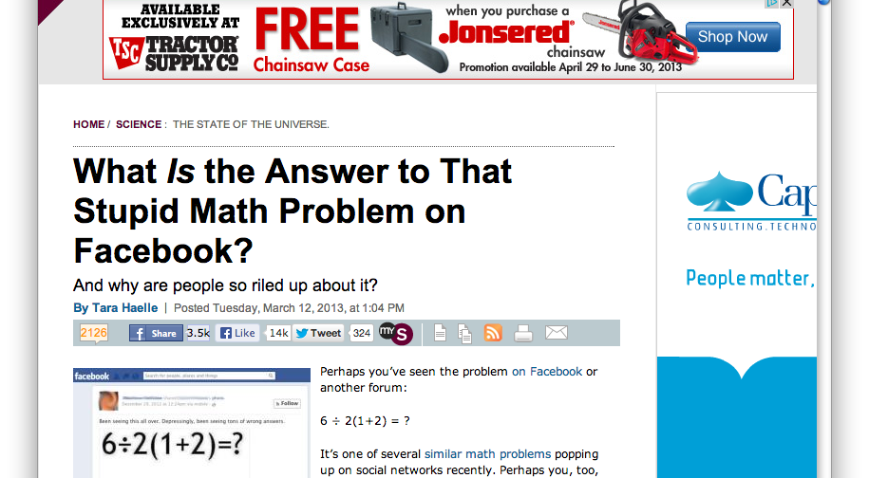
Parsing as a general problem:
Notes:
To show just how general, I thought I’d throw in a screenshot of this Slate article discussing how even for very basic math there is no consensus on how to parse things—in this case whether the the multiplication or the division has higher precedence.

Slide 49
Parsing in Coq is especially difficult
Lots of big, complicated expressions, e.g.*
aevalR_ind =
fun (P : aexp -> nat -> Prop) (f : forall n : nat, P (ANum n) n)
(f0 : forall (e1 e2 : aexp) (n1 n2 : nat),
e1 || n1 ->
P e1 n1 -> e2 || n2 -> P e2 n2 -> P (APlus e1 e2) (n1 + n2))
(f1 : forall (e1 e2 : aexp) (n1 n2 : nat),
e1 || n1 ->
P e1 n1 -> e2 || n2 -> P e2 n2 -> P (AMinus e1 e2) (n1 - n2))
(f2 : forall (e1 e2 : aexp) (n1 n2 : nat),
e1 || n1 ->
P e1 n1 -> e2 || n2 -> P e2 n2 -> P (AMult e1 e2) (n1 * n2)) =>
fix F (a : aexp) (n : nat) (a0 : a || n) {struct a0} : P a n :=
match a0 in (a1 || n0) return (P a1 n0) with
| E_ANum n0 => f n0
| E_APlus e1 e2 n1 n2 a1 a2 =>
f0 e1 e2 n1 n2 a1 (F e1 n1 a1) a2 (F e2 n2 a2)
| E_AMinus e1 e2 n1 n2 a1 a2 =>
f1 e1 e2 n1 n2 a1 (F e1 n1 a1) a2 (F e2 n2 a2)
| E_AMult e1 e2 n1 n2 a1 a2 =>
f2 e1 e2 n1 n2 a1 (F e1 n1 a1) a2 (F e2 n2 a2)
end
User defined notations (e.g. “+” and “/\”) with user defined precedences and associativities,
* Term constructed in Benjamin C Pierce, Chris Casinghino, Michael Greenberg, Vilhelm Sjoberg, and Brent Yorgey. Software foundations. Course notes, online at http://www. cis. upenn. edu/ ̃ bcpierce/sf, 2010.
Notes:
The situation is especially bad in Coq, even by Computer Science standards I think, because we have lots of big, complicated expressions,
And the tool allows user defined notations with user defined precedences and associativities

Slide 50
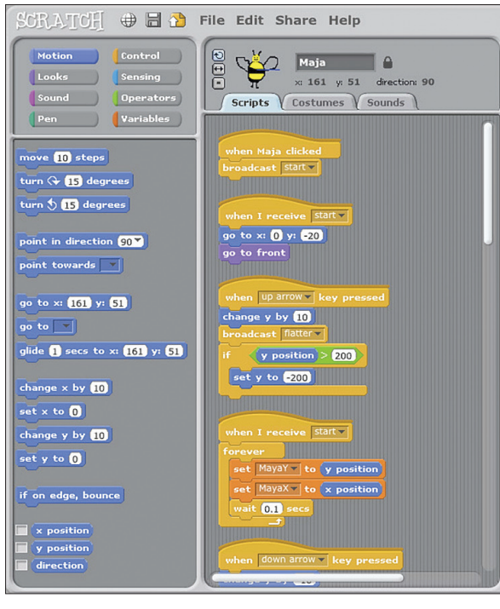
Existing solution example
Mitchel Resnick, John Maloney, Andrés Monroy-Hernández, Natalie Rusk, Evelyn Eastmond, Karen Brennan, Amon Millner, Eric Rosenbaum, Jay Silver, Brian Silverman, and Yasmin Kafai. “Scratch: Programming for All”. Communications of the ACM 52(11):60-67 (2009)
Notes:
One system that tries to solve the problems of helping people to understand and manipulate structured text is the educational programming environment “Scratch”. The idea here is to construct programs by selecting these program blocks, dragging them over, and connecting them into scripts. One of the great advantages of this is that you can’t make syntax errors.

Slide 51
Syntax-directed editing issues (1/2)
Q: How can we both
visualize how text is structured when nesting is very deep, like in Coq, and
make it easy to see the correspondence between the visualization and the text as it appears in an editor?
Notes:
In general, these sorts of systems, where one is manipulating grammatically meaningful chunks of text rather than individual characters, are called syntax-directed editors.
The first question that one might ask oneself when looking at a system like Scratch is…

Slide 52
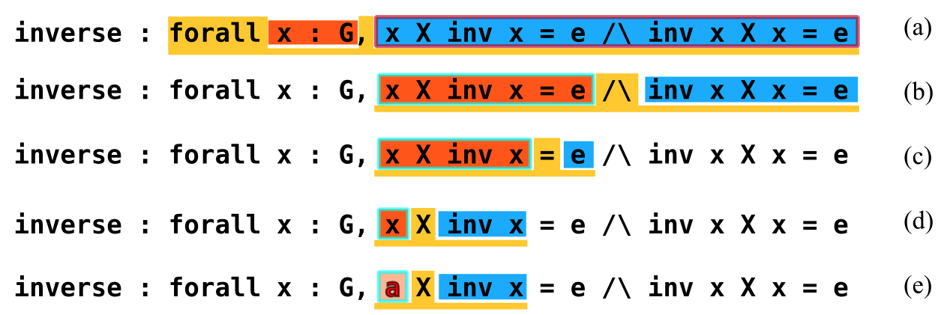
Solution: Syntax Tree Highlighting
Notes:
I’ve come up with a particular solution, here; I’m just calling it “syntax tree highlighting”…
and here we see how the highlighting can be moved through the syntax tree of some text to show notations and their precedences, and to allow particular sections of text to be selected for typechecking, evaluation, or, in this case, rewriting.

Slide 53
Syntax-directed editing issues (2/2)
Q: How to make systems like Scratch efficient?
A: Interact using keyboard shortcuts/commands
Q: What is it about systems like Scratch that make them easy for novice users?
A: It has menus that constrain users’ actions to commands that actually do things
Q: So why not just provide menus for novice users and keyboard shortcuts for experts?
A: Novice users will often never learn the shortcuts
Q: How do we avoid this?
Notes:
There are, however, more questions to ask oneself.
First, how do we make programming in system like Scratch efficient enough that, say, a professional programmer would want to use it?
The general answer, when it comes to making software more efficient for expert users, is to add keyboard shortcuts, or short keyboard commands.
Figuring out how to do this well, however, is especially challenging here because we wants to make entering the keyboard shortcuts faster than just typing the text into a normal text editor.
We may then ask ourselves, well what exactly is it about systems like Scratch that make them easy for novice users?
At least a partial answer to this is that it essentially has menus that constrain users’ actions to commands that actually do things.
So then, why shouldn’t we just provide menus for novice users and keyboard shortcuts for experts?
The problem is that novice users will often never learn the shortcuts. This is a big enough problem that it even has a name: The Paradox of the Active User. Basically, what this is pointing out is that users are normally too busy using a system to actually figure out how to use it well.

Slide 54
Solution: Keyboard-Card Menus
A scheme for teaching users shortcuts as they explore menus
The shortcuts they teach are a little unusual
I’ve been calling them “rolled-chord” shortcuts
Have to switch from normal typing mode to command mode
Use character keys as modifier keys
E.g. instead of CTRL-I, press S-I
Hundreds of commands can be invoked very quickly
Notes:
The solution to this that I came up with, Keyboard-Card menus, is basically a scheme for teaching users shortcuts as they explore menus.
The shortcuts they they are a little unusual.
I’ve been calling rolled-chord shortcuts,
And to use them one has to switch from normal typing mode to command mode.
Once you have done this, though, you can use the character keys as modifier keys,
so, for instance, instead of Ctrl-I, you can press S-I
This allows hundreds of commands to be invoked very quickly.

Slide 55
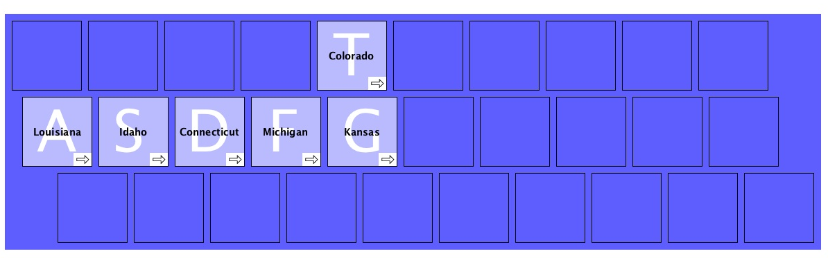
Keyboard-Card Menus
Notes:
Here’s what they look like.
Initially, with no fingers pressing any keys, one will see a base keyboard-card.
Then, when you press--and hold down– the S key, for instance, you can navigate to a submenu …

Slide 56
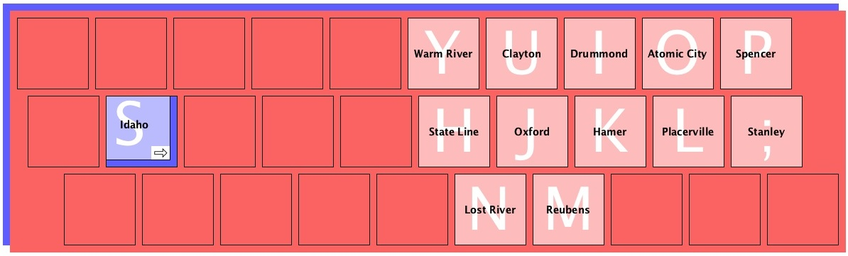
Keyboard-Card Menus
Notes:
… which is another keyboard-card, stacked on top of the original and with a hole conveniently “punched out” to show how you got here.
One of the advantages is that if you don’t see what you are looking for in the submenu, all you have to do is, in this case, release the S key.
The big advantage, though, is that by selecting menu items you are actually physically rehearsing the process of invoking the shortcut.
So S…I eventually becomes S-I.

Slide 57
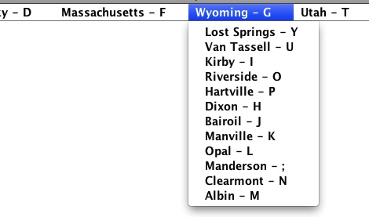
Keyboard-Card Menus
I’ve run an experiment comparing KCMs’ presentation of these shortcuts with a presentation based on dropdown menus
Presenting the results, which show a statistically significant advantage in shortcut learnability, at Interaccion in September
Notes:
I’ve also run an experiment comparing Keyboard-Card menus’ presentation of these shortcuts with this presentation using dropdown menus.
I’ll be presenting the results, which show a statistically significant advantage in shortcut learnability, at the Interaccion conference in September.

Slide 58
Extension #3: “Propositional Logic Syntax Shortcuts”
Combine Keyboard-Card Menus and Syntax Tree Highlighting
Build up/edit code from a small subset of Coq
This subset consists of Fitch-style proofs in Classical Propositional Logic
Normally a hack in Coq
Adding axioms so as to follow Huth & Ryan’s textbook
This should allow the extension to be particularly useful in education
Notes:
The idea behind Propositional Logic Syntax Shortcuts is to combine Keyboard-Card menus and Syntax Tree Highlighting in order to build up and edit code from a small subset of Coq.
This subset consists of Fitch-style proofs in Classical Propositional Logic, which is normally a hack in Coq.
I’m also going to add axioms so as to follow the popular Huth and Ryan Logic in CS textbook
which I’m hoping will make the extension useful in teaching.

Slide 59
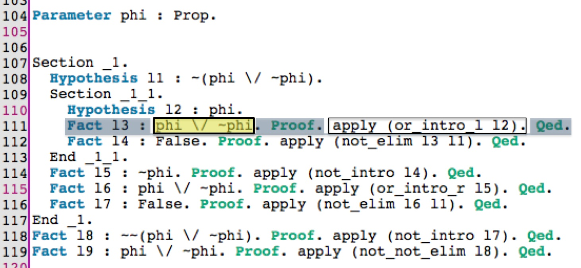
Extension #3: “Propositional Logic Syntax Shortcuts”
Notes:
Here we can see how we can use Coq’s section mechanism, along with indentation, where normally we would use boxes.
We can also see the syntax tree highlighting showing a particular node, and its children.

Slide 60
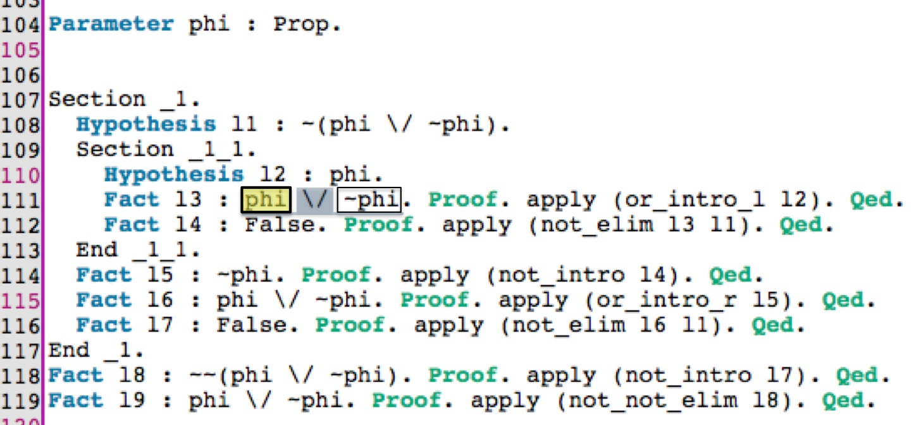
Extension #3: “Propositional Logic Syntax Shortcuts”
Notes:
We can move to the selected child node…

Slide 61
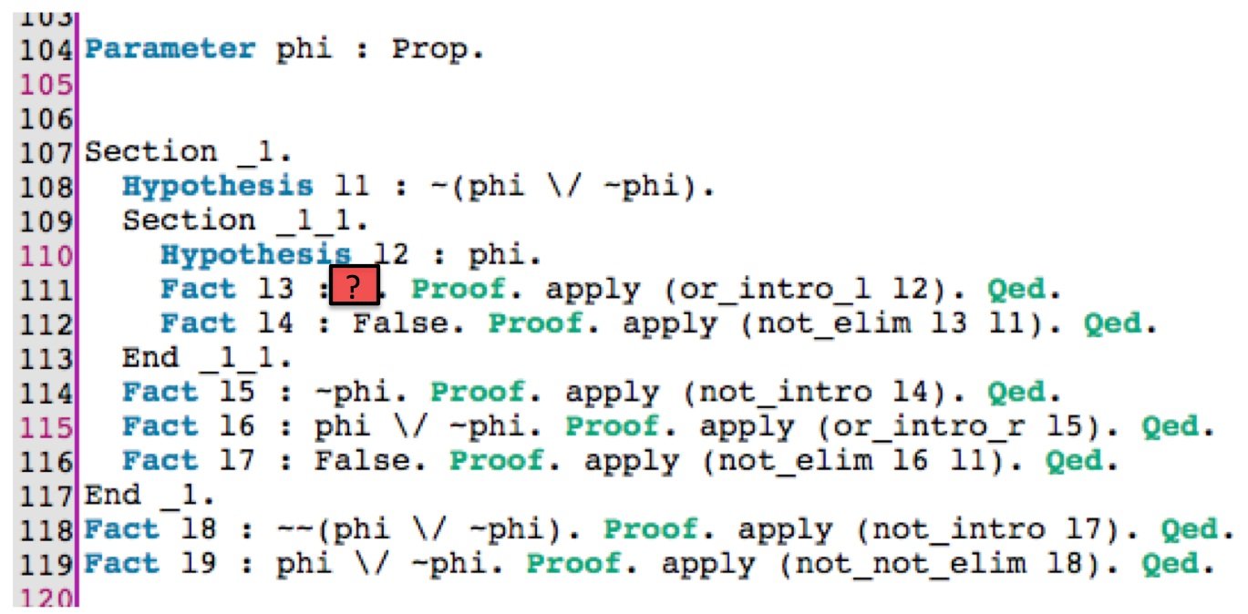
Extension #3: “Propositional Logic Syntax Shortcuts”
Notes:
…and we can replace that child node with a placeholder.

Slide 62
User Testing
Test Proof Previews and Proof Transitions with 16 new users (computer science students)
Train each participant for 45 minutes
Have each participant explain four complicated proofs they are given, two using Proof Transitions and two without
These explanations will be video recorded and graded
Have each participant prove up to 20 simple theorems, 10 with Proof Previews and 10 without, with up to 15 minutes for each set
Have participants fill out satisfaction/preferences questionnaires
Notes:
Roughly what we are going to do is…

Slide 63
Rough Schedule
Revised version of CoqEdit, the Proof Previews plugin, and the Proof Transitions plugin by September
Proof Previews/Transitions testing: September/October
Propositional Logic Syntax Shortcuts development: October-January
Further refinement of plugins, public release of plugins/source code/documentation, dissertation writing: February-April
Dissertation Defense: May

Slide 64
Conclusion
ITPs, particularly Coq, are important tools for developing proofs and reliable computer systems
They are complex and hard to learn and use
Research Goals: Develop ideas for user interfaces that make using Coq and other ITPs, along with coding in general, easier
Research Strategy:
Develop a basic user interface that can be extended
Develop experimental extensions
Test these the UI with extensions against the basic UI
Notes:
To conclude,
Interactive theorem provers, particularly Coq, are important tools for developing proofs and reliable computer systems
They are, however, complex and hard to learn and use
My research goals are to develop ideas for user interfaces that make using Coq easier, and also make coding in general easier
My research strategy is to develop a basic user interface that can be extended,
develop experimental extensions,
and test these extensions against the basic user interface.

Slide 65
Thanks!

Slide 69
Outline
My general goals
Theorem Proving with Coq
Briefly go through an example
Survey—evidence of room for improvement
Research Plans
General strategy
Specific problems I’m addressing
User testing
Possibly unique for this sort of work
Rough timeline for research
Notes:
Here’s an outline of this talk.
I’m going to start by discussing my general goals and some of their motivation
I’m going to briefly go through an example of theorem proving with Coq to give you at least a little bit of a sense of some of the challenges I am trying to help out with
I’ll talk a little about a survey that was sent to Coq users and which gives additional evidence that there is room for improvement
I’ll then talk about my research plans, including my general strategy, specific problems I’m addressing, and some planned user testing.
I should say that this user testing, and the user-centered approach being used here, is pretty unusual for projects of this sort, probably unique, and I’ve been lucky enough to have the combination of Professors Stump and Hourcade involved in this project.
And I’ll conclude with a rough timeline for the research.

Slide 70
Survey
My general impression from the responses:
Appreciation of existing interfaces
Some specific tasks we identified as difficult were indeed perceived as difficult, including
understanding the relationships between subgoals
switching back and forth between potential subgoal proofs
comparing similar subgoals
telling what options are available for proving a subgoal
Many helpful features could be added, in particular:
features seen in programming IDEs, like refactoring
representations of proof structure
Notes:
I’m not going to go into any of the details of the survey, but my general impression from the responses was that
while there is appreciation for existing interfaces
some tasks that we identified as difficult were indeed perceived as difficult and
many helpful features could be added, especially features seen in programming environments and ways of representing proof structures.

